Slide 1
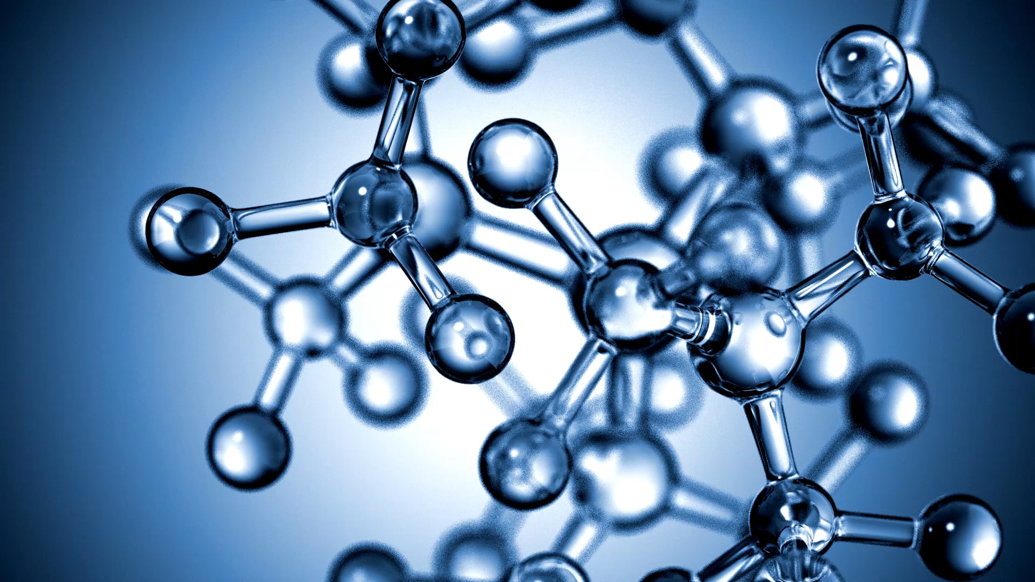
DNA coding
ATHBY Human Biology

Slide 2
Review
Nucleotide Labeling Quiz (purposegames.com)
List the two complementary pairs for nitrogenous bases.
Compare and contrast nuclear and mitochondrial DNA (8 marks)

Slide 3
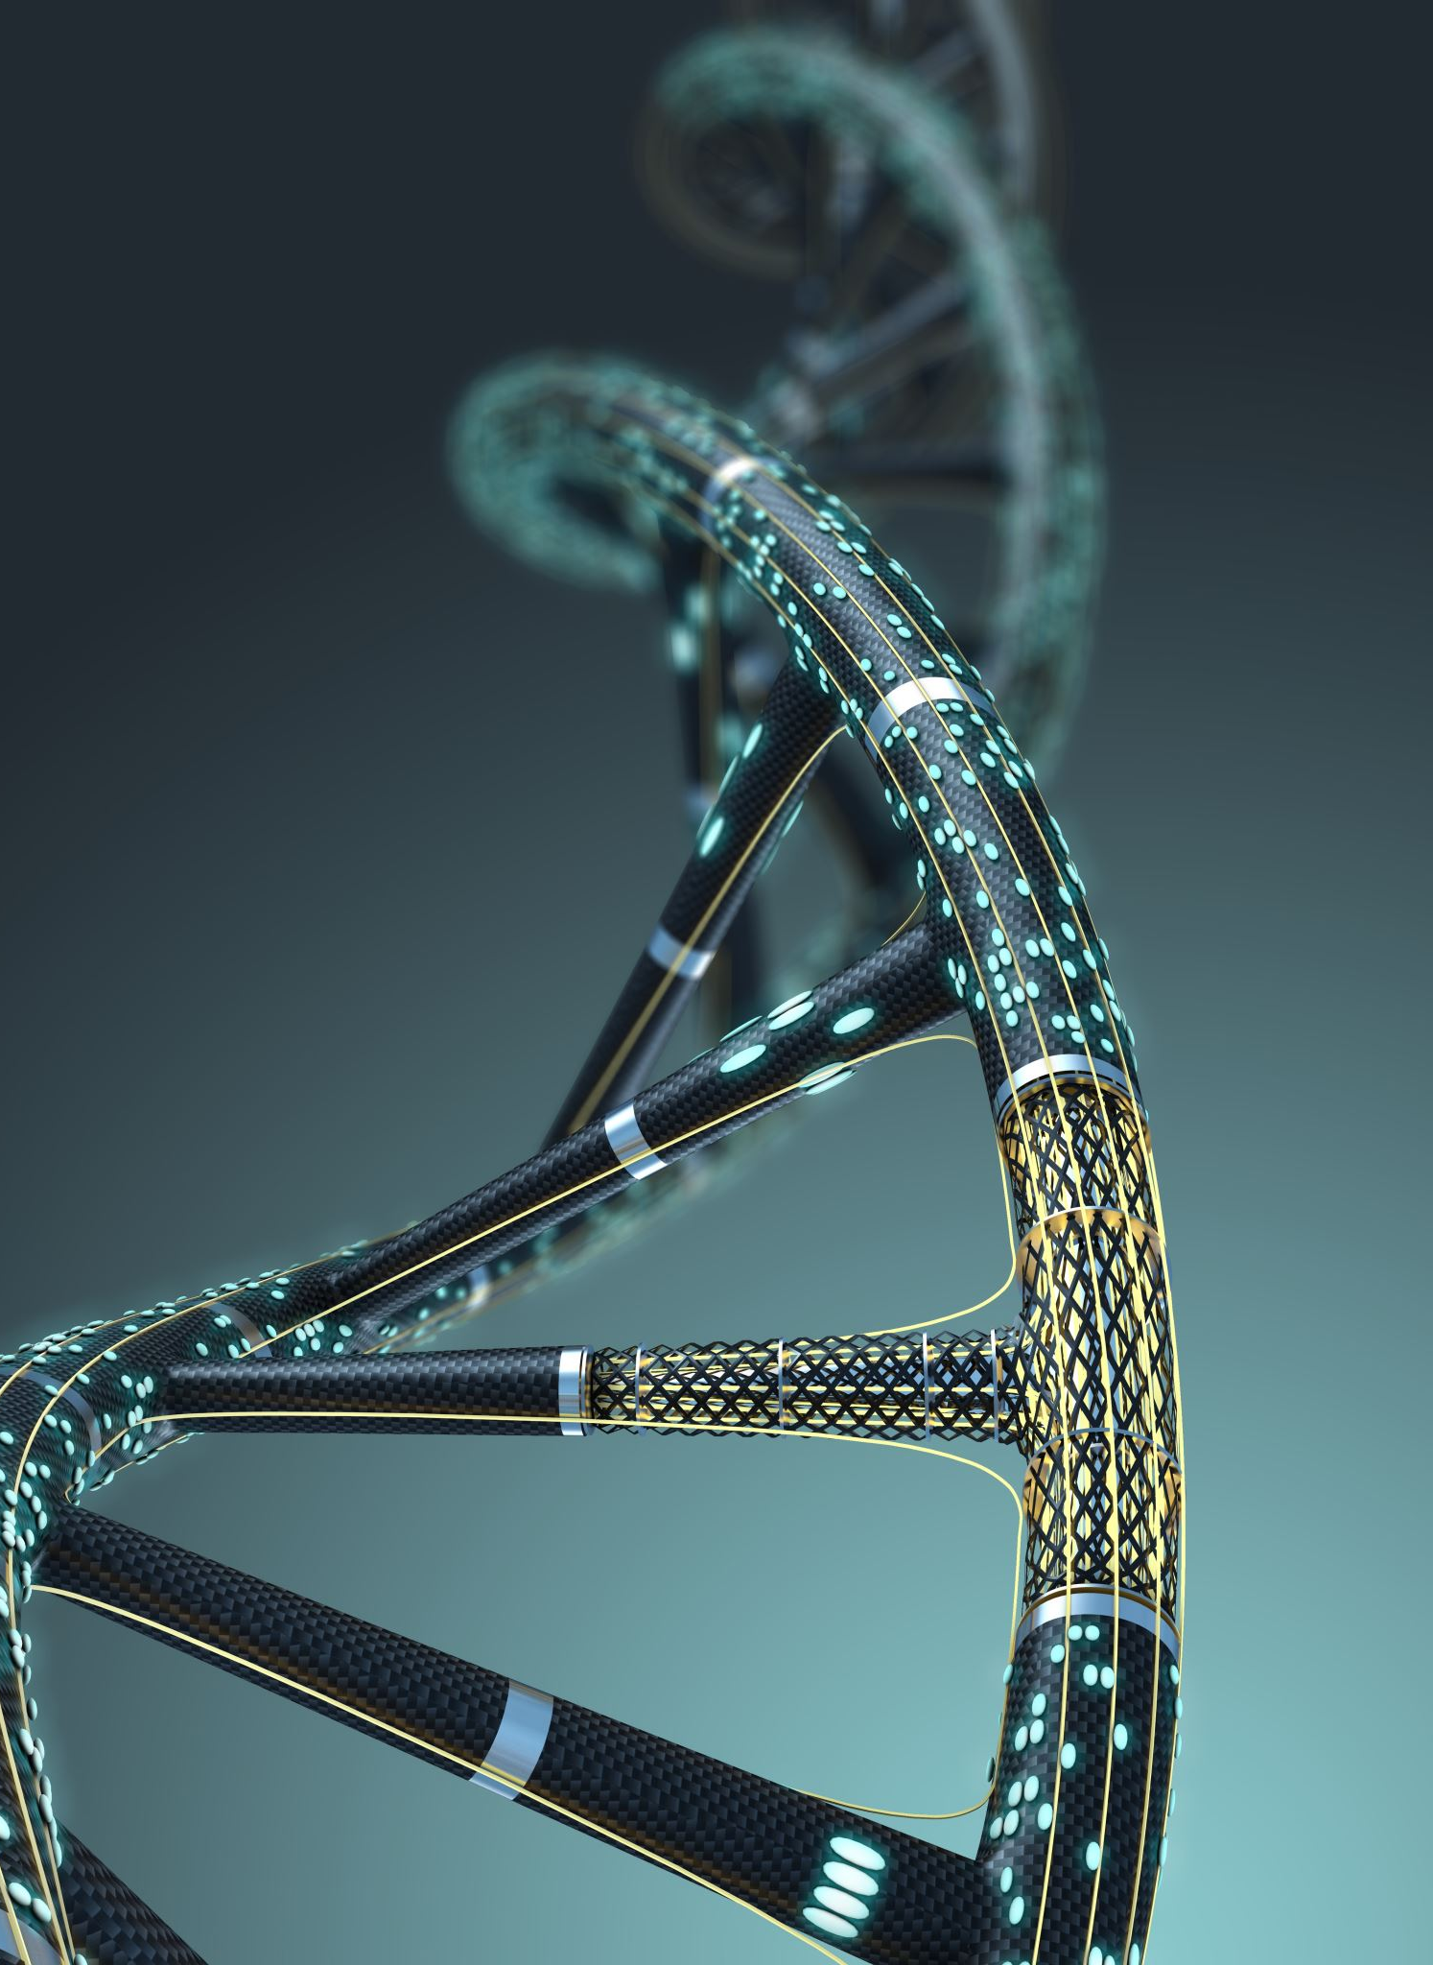
Learning Intentions
DNA stores the information for the production of proteins that determines the structure and function of cells.

Slide 4
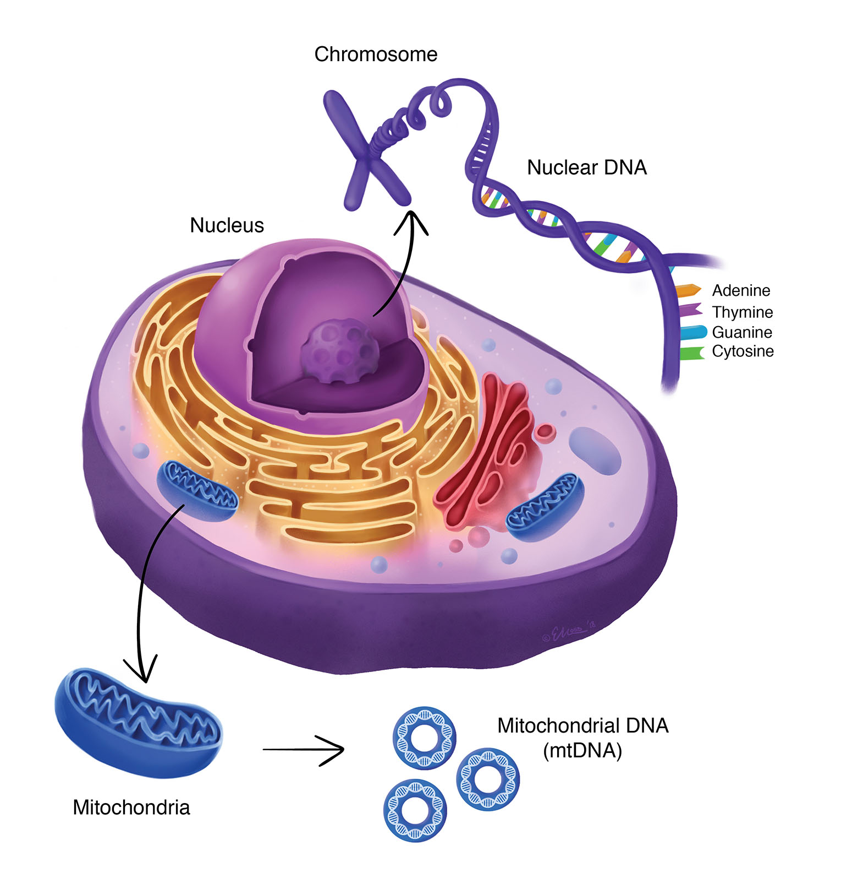
Success criteria
Define triplet (codon)
Use charts to determine which triplet code (codon) relates to each of the amino acids found in human proteins.

Slide 5
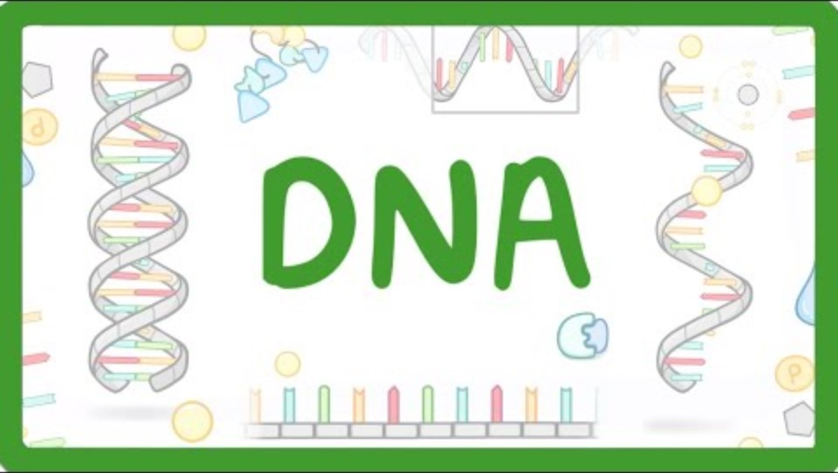

Slide 6
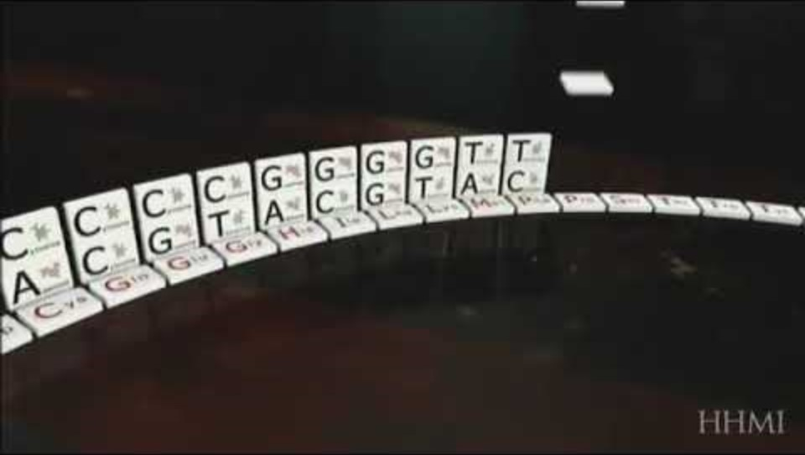

Slide 7
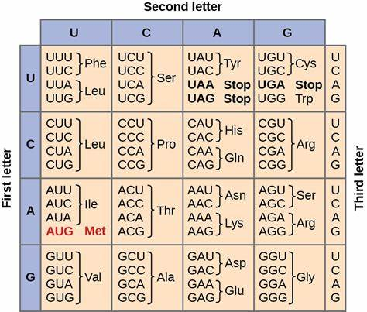

Slide 8
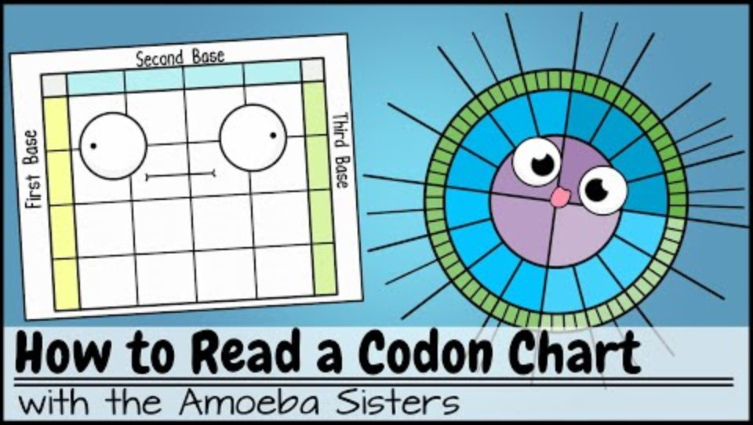

Slide 9
Success criteria
Define triplet (codon)
Use charts to determine which triplet code (codon) relates to each of the amino acids found in human proteins.

